Slide 1
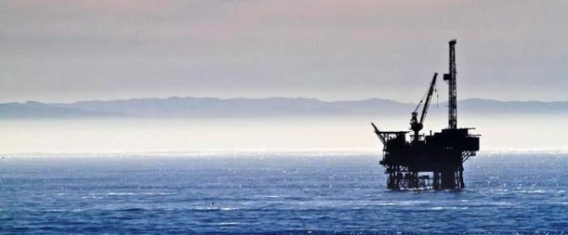
Predicting Equipment Survivability
Author: Winson

Slide 2
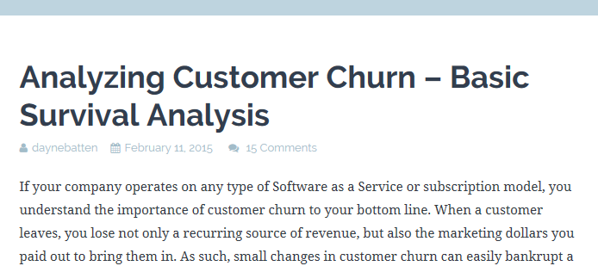

Survival Analysis Usage
Bio-science
Equipment survival

Slide 3
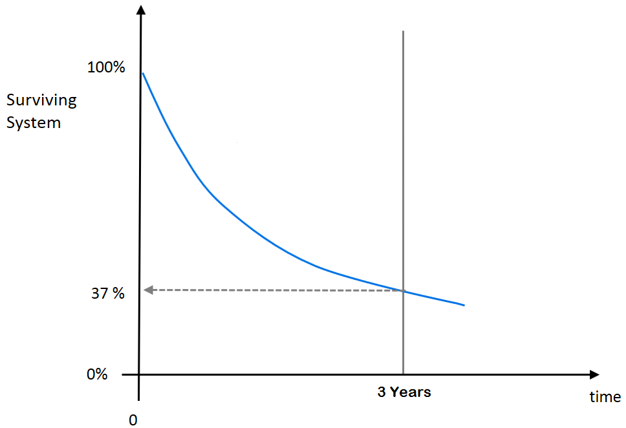
Oil Production Business
Equipment deployed downhole to pump oil may cost few thousands to millions per well.
The ability to predict survivability over time of the downhole equipment installed at the different downhole environment variables will allow
Better return of investment (ROI) calculation
Strategy of equipment selection
Equipment improvement to meet survivability expectation
Failure planning (minimize cost impact)

Slide 4
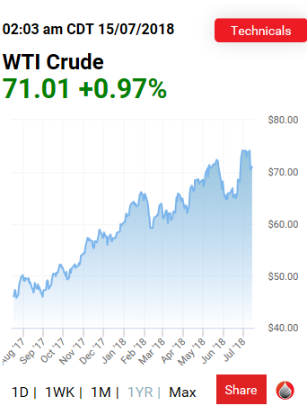
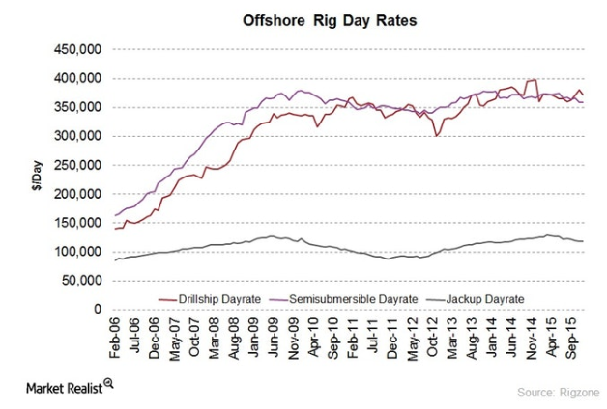
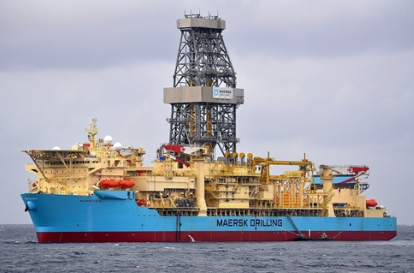
Assuming 1 week of equipment down time
Rig ship
Do the math:
Production loss: If 1000 BOPD → 1000*$70*7days = $490K
Rig cost for 7 days: If $350K/day → ~$2.5M

Slide 5
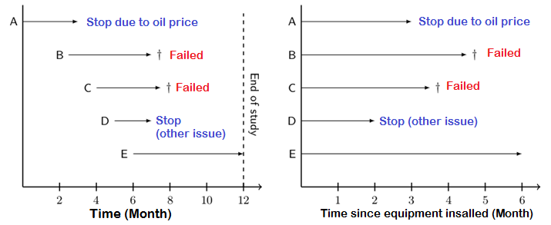
Survival Analysis Introduction
It differs from traditional regression by the fact that parts of the training data can only be partially observed – they are censored.
Survival analysis involves the modelling of time to failure.
Example question of interest:
What is the probability of the equipment to survive x months?
Are there factors impacting the survivability?
Given a specific conditions (features), what will be the equipment survivability over time?
Note: The survival prediction is not about fail or not fail, but the probability of survival.
Note:
We cannot just assume the survivability at 6 months is 1/5 as A & D not yet failed (they were just stopped before 6 months).
It is also incorrect to say the survivability is 3/5 as we do not know A & D will fail or not if they were not stopped early.

Slide 6
Problem Statement
Is there a subgroup(s)/factor(s) that differ in survival?
Can we predict the survivability of the equipment over time given particular factors combination?

Slide 7
Project Dataset
A type of equipment installed downhole for oil production.
The real identity and source of the data has been masked (confidential).
Original dataset consists of 106 features and ~8000 instances over 3 years (2015-2017). A small subset of features in particular interest are studied based on the application knowledge.
Split the data into train set (year 2015-2016) and test set (year 2017)

Slide 8
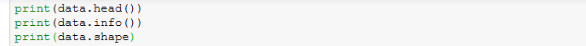
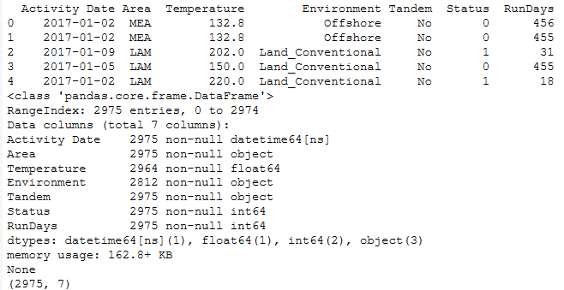
Test Set
Legend:
Activity Date: When the equipment was installed
Area: Which geographical area the equipment was installed. Total of 5 areas.
Temperature: The downhole temperature the equipment was exposed to.
Environment: What kind of application environment. 3 categories.
Tandem: More than 1 equipment is installed in series? Yes/No
Status: True = Failed. False = Survived/Censored
RunDays: Survival time in days since equipment installation.

Slide 9
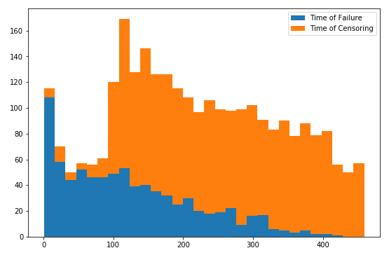
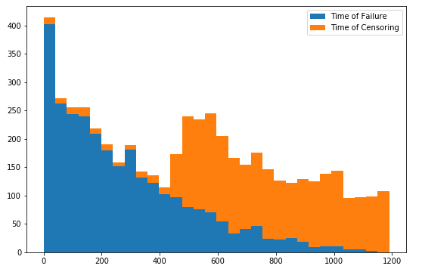


EDA Analysis
Note: For survival analysis, label data (y) does not need to be balanced.
Test set: Censor/Failure ratio: 2000/802
Train set: Censor/Failure ratio: 2413/2855

Slide 10
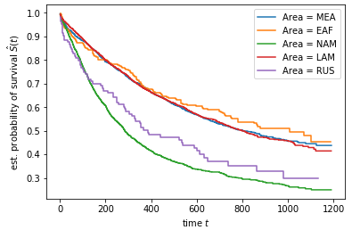

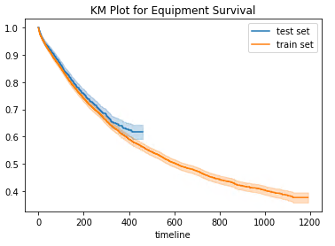
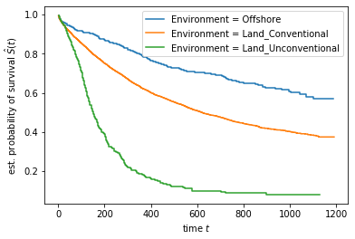
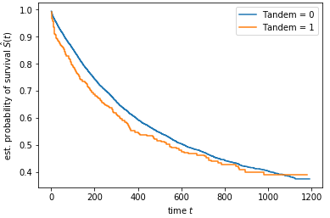
By area (train):
Non Parametric Model
Kaplan Meier (KM) Plot
Overall:
By environment (train):
By equipment configuration (train):
Note: KM analysis cannot vary and compare multiple variables at the same time

Slide 11
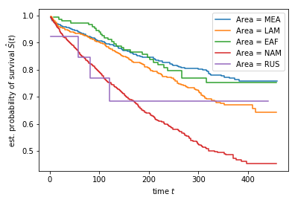
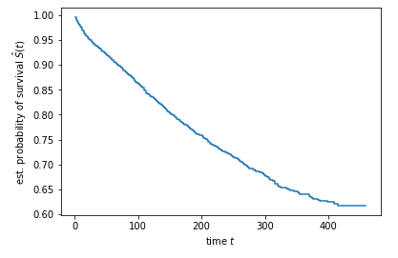
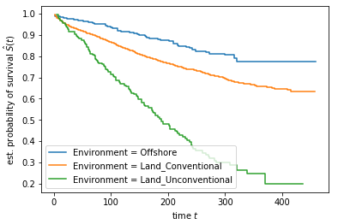
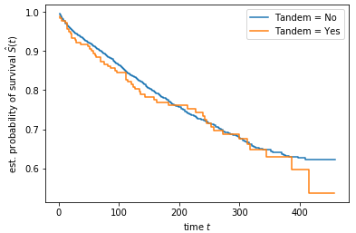
By area:
Non Parametric Model (Test Set)
Kaplan Meier (KM) Plot
Overall:
By environment:
By equipment configuration:
Note: KM analysis cannot vary and compare multiple variables at the same time

Slide 12
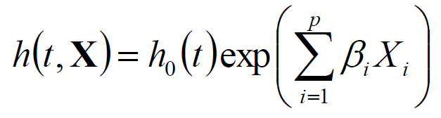
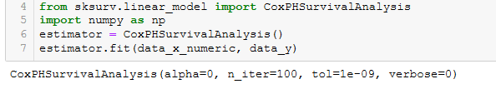
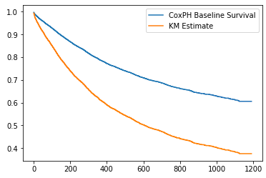
Multivariate Survival Model
Cox-Proportional Hazard
Time + linear regression
Fitting the model
#Interpretation:
A small spread between these two curves means that the impact of the exponential in the Cox model does very little, whereas a large spread means most of the changes in individual hazard can be attributed to the exponential term.
For example, the large spread of this graph indicate a good fit

Slide 13
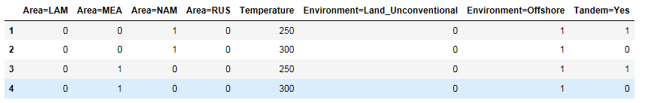
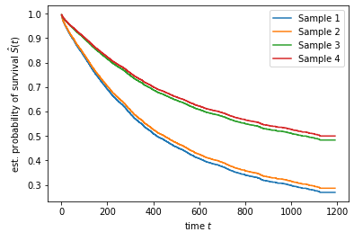
Prediction
Predictors:

Slide 14
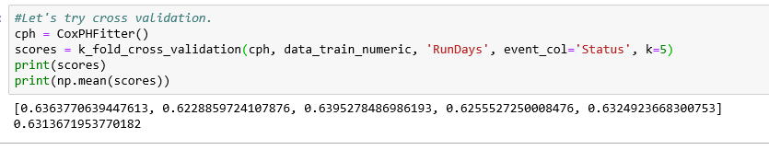

Model Score: Concordance Index (C-index)
K-fold cross validation with train dataset:
Evaluate the test dataset:
Remark: Better than random. Room for improvement.
Notes:
http://www.statisticshowto.com/c-statistic/

Slide 15
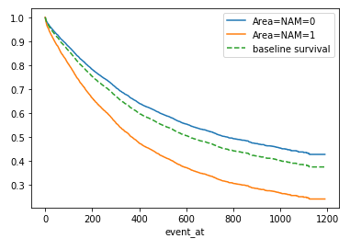
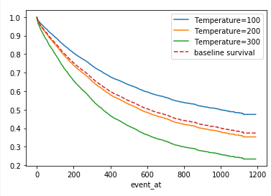
Checking the impact of a specific variable while keeping other variables constant

Slide 16
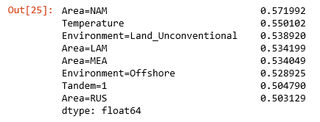
Feature Selection Attempt 1:
Fit a Cox model to each variable individually and record the c-index on the training set:
Feature ranking

Slide 17
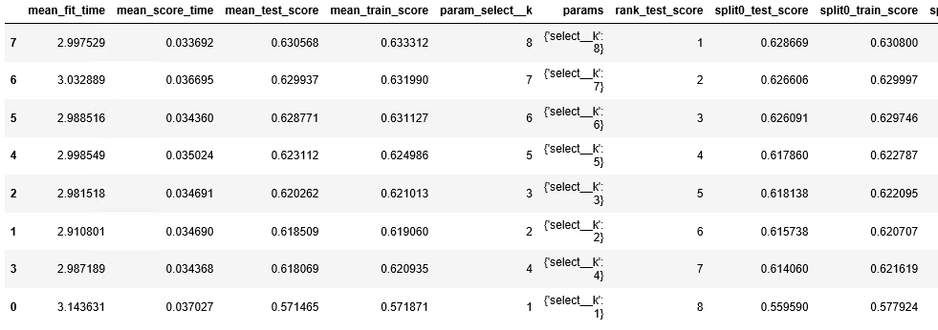
Feature Selection Attempt 2:
Attempt to do feature reduction.
Use SelectKBest and GridSearchCV (optimize the parameter k of the SelectKBest class)
Result suggested to use all features, not really helpful.

Slide 18
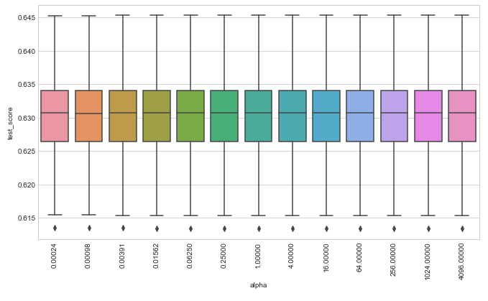

Try other models
Cos regression with Elastic Net (CoxnetSurvivalAnalysis):
Fast Survival Vector Support Machine (FastSurvivalSVM):
Improvement is very minor
Result is poorer

Slide 19
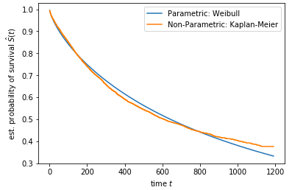
Parametric Model
Remark:
Weibull is a good fit

Slide 20
Comments
Is there a subgroup(s)/factor(s) that differ in survival?
Yes. Visualization using non-parametric KM model can clearly distinguish the effect of different variables to the survivability plot.
Can we predict the survivability of the equipment over time given particular factors combination?
Yes. Multivariate survival models such as CoxPHSurvivalAnalysis and FastSurvivalSVM can be used to do the prediction. Multiple attempts using features selections methods and different models not able to improve the prediction score further.
Potential future works:
Include other potential features for modelling
Perform features engineering
Try other survival models (e.g. time varies covariate, deep learning)

